Slide 1


Machine learning final-project
Detecting Chronic Kidney Disease Using ML
PANKAJ BALOTRA (87034917)
VRISHABH UPPAL(62369068)

Slide 2
CONTENT:
1. Introduction
1.1 Objective 1.2 Importance
2. Dataset Overview
2.1 Features 2.2 Target Variable
3. Data Pre-processing
3.1 Cleaning 3.2 Imputation 3.3 Exploratory Data Analysis (EDA)
4. Model Development
4.1 Neural Network
5. Training and Evaluation
5.1 Data Splitting 5.2 Model Training 5.3 Model Evaluation
6. Results
6.1 Model Performance
7. Conclusion
7.1 Key Takeaways

Slide 3
introduction
Objective: Predict Chronic Kidney Diseases (CKD) using machine learning.
Importance: Early detection for effective management

Slide 4
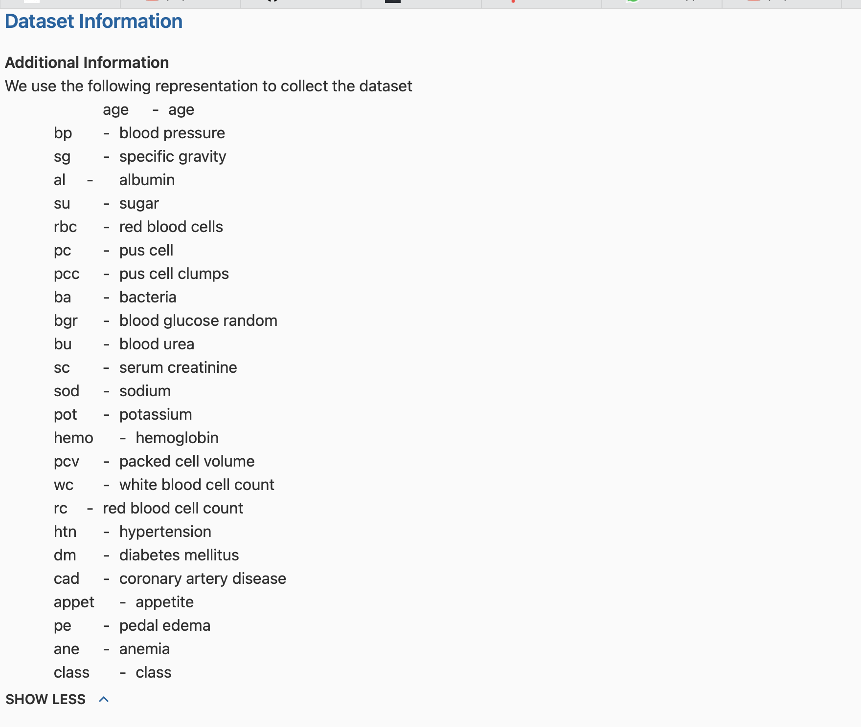
Dataset overview
Data contain 400 row and 26 columns
Features: Age, blood pressure, specific gravity, albumin, sugar, etc.
Target Variable: 'class' indicates CKD or not
Is the target variable

Slide 5

Data pre-processing
Cleaning: Handled missing values, fixed inconsistent entries.
Imputation: Used mean, median, and mode for numerical and categorical data.
EDA: Explored unique values, checked class distribution.

Slide 6
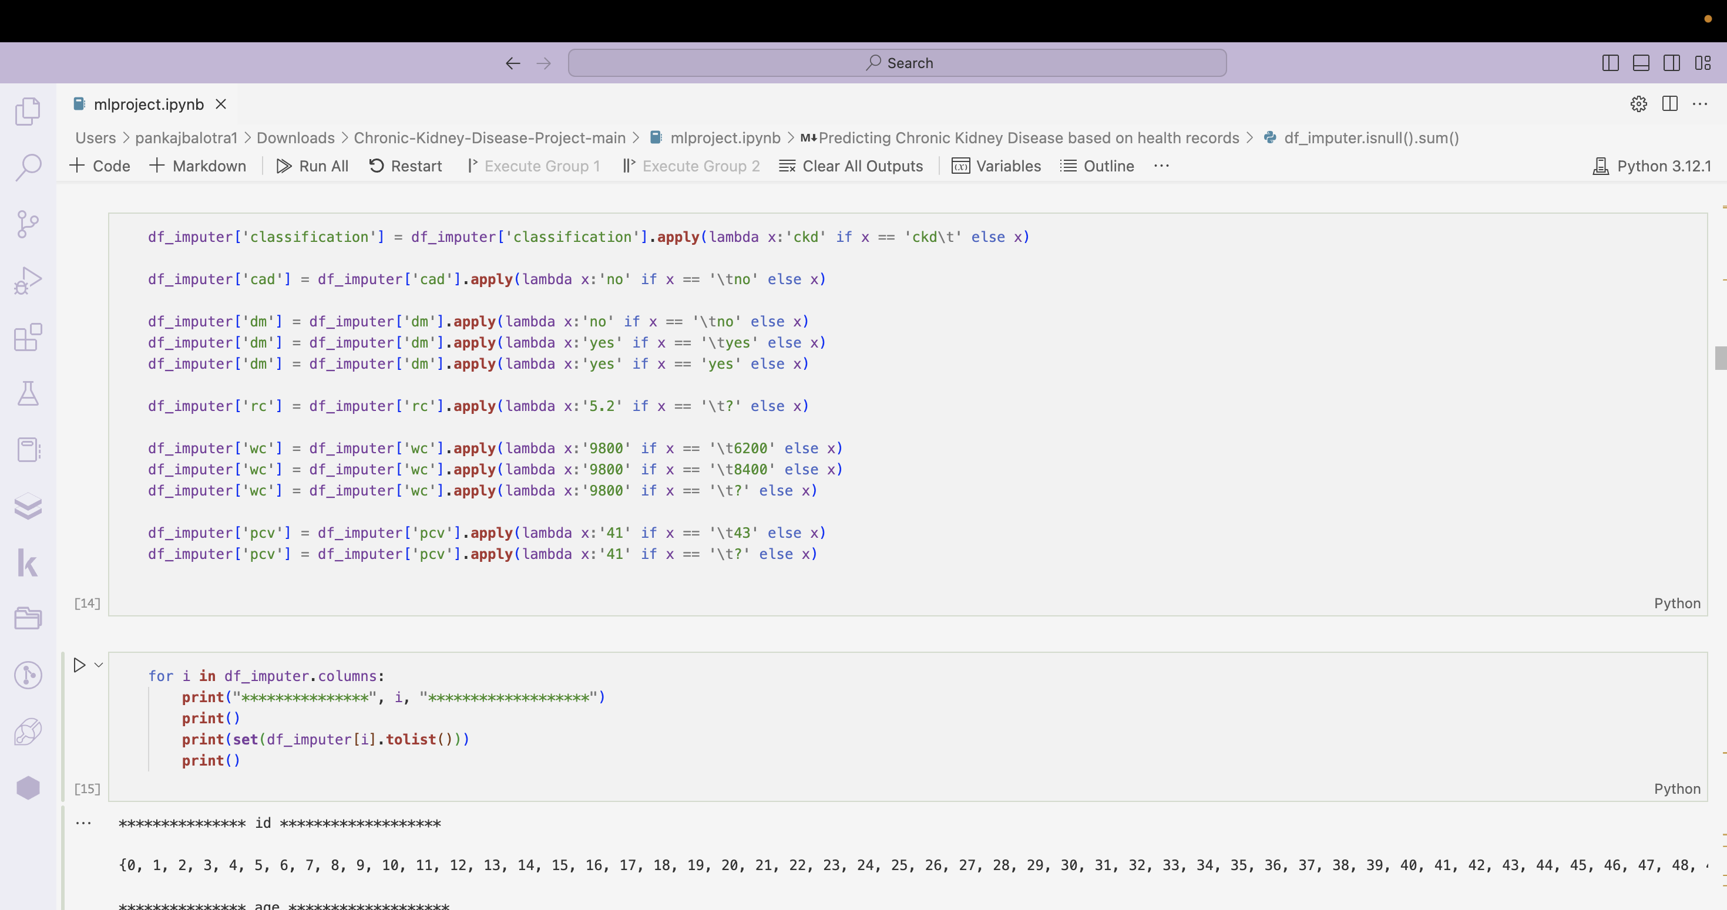

Slide 7

Balancing the data before modling
Used random over sampler to balance the data
Use min maxscaler to scale dta(-1,1)

Slide 8
neural network

Slide 9
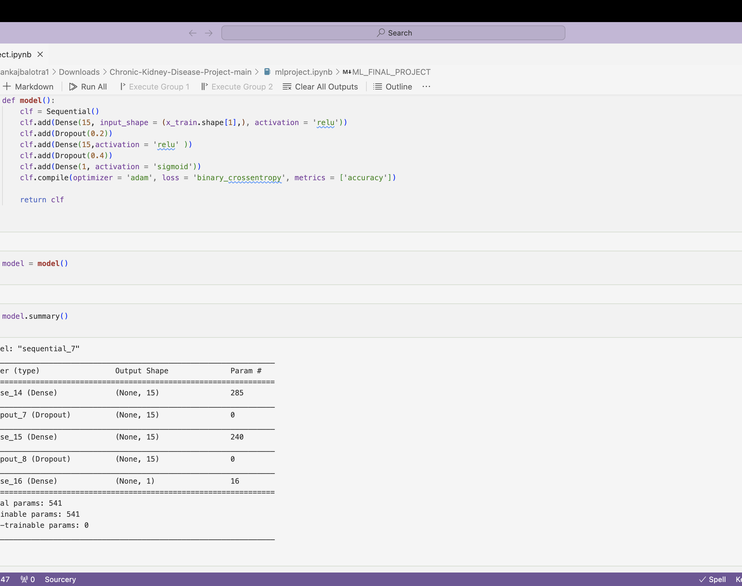
Model devepment
Neural Network: Keras model with two hidden layers for binary classification and one final layer.
Adam optimizer and binary crossentropy loss.
Param = input * Wegith + bais

Slide 10
Training and evaluation
Data Splitting: 80-20 split for training and testing.
Model Training: at 5 Epox first and after that we Trained for 20 epochs to learn patterns.
Model Evaluation: Analyzed ROC curves, precision-recall curves, and F1 scores.

Slide 11
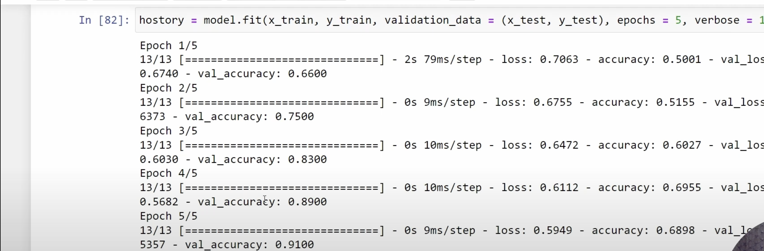
At 5 epoch

Slide 12
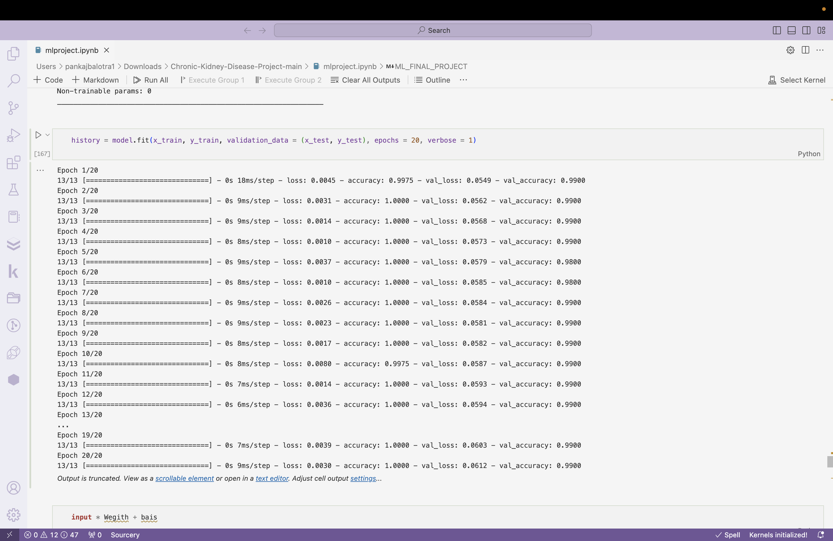

Slide 13
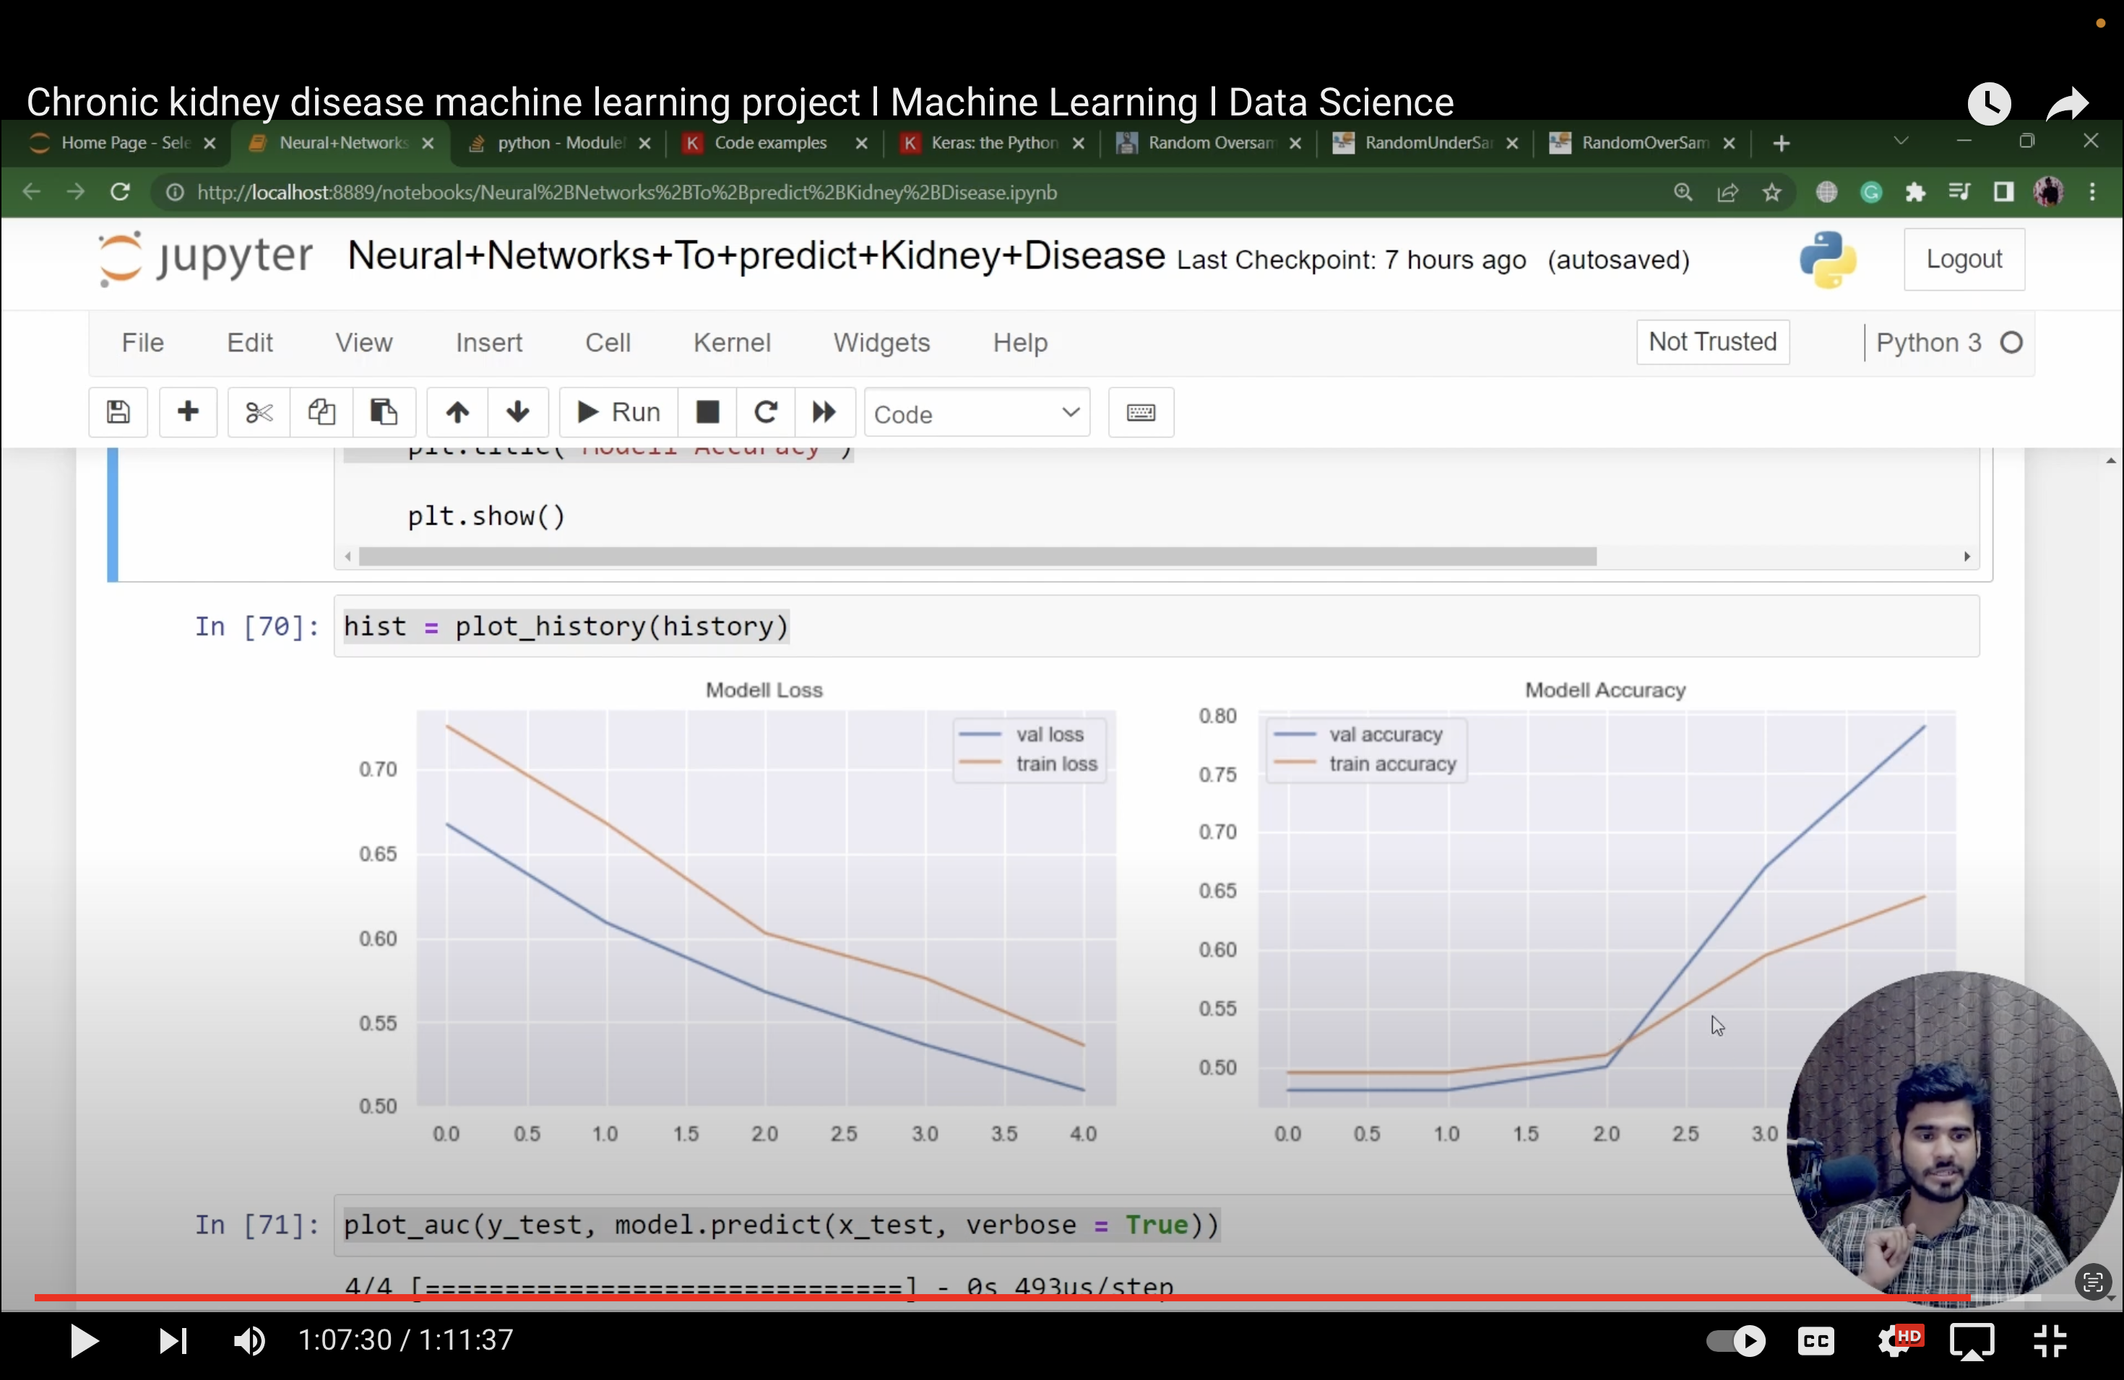
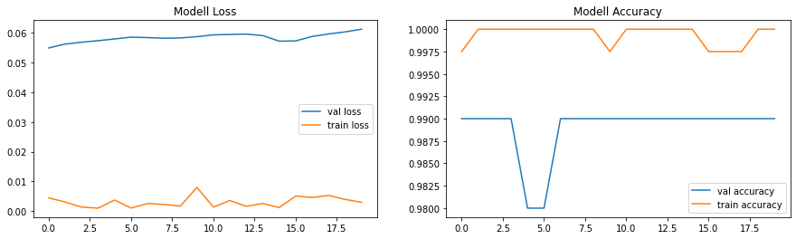
results
The trained model demonstrated robust performance in predicting individuals at risk of chronic kidney diseases. The ROC and precision-recall curves showcased high AUC and average precision scores, emphasizing the model's effectiveness.

Slide 14
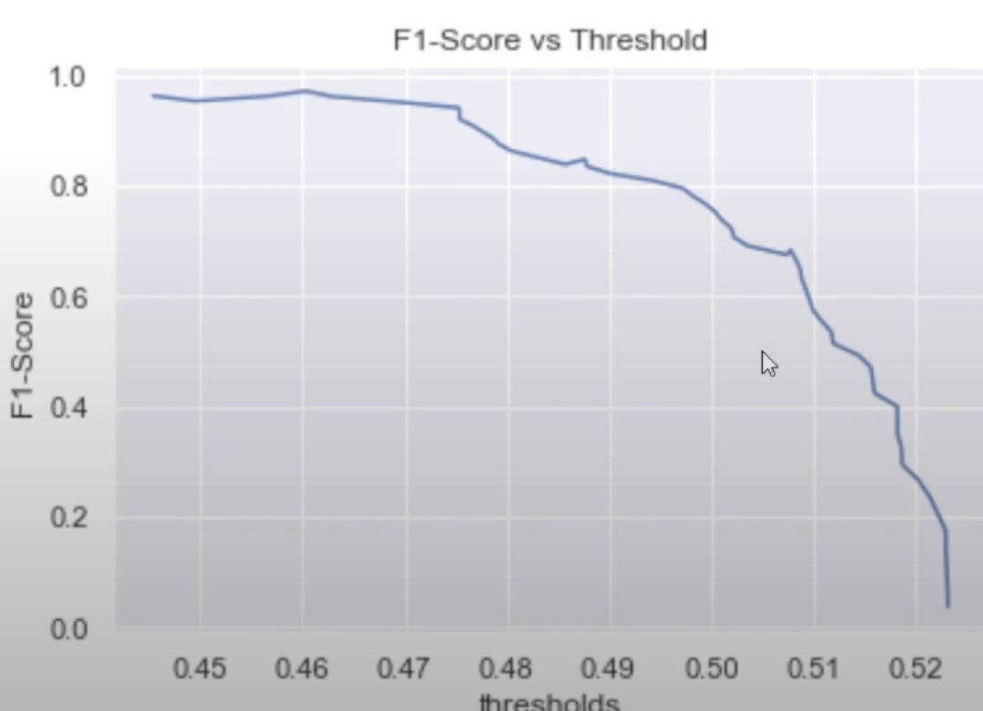
Result slide2
This show that our F1 score is decreasing.
Precision: 0.9622641509433962
Recall: 0.9807692307692307
Threshold: 0.46036607
F1 Score: 0.9714285714285713
Conclusion:
We can make our model more refine by adding more data to it.

